Slide 1

Linduino
Dan Eddleman

Slide 2
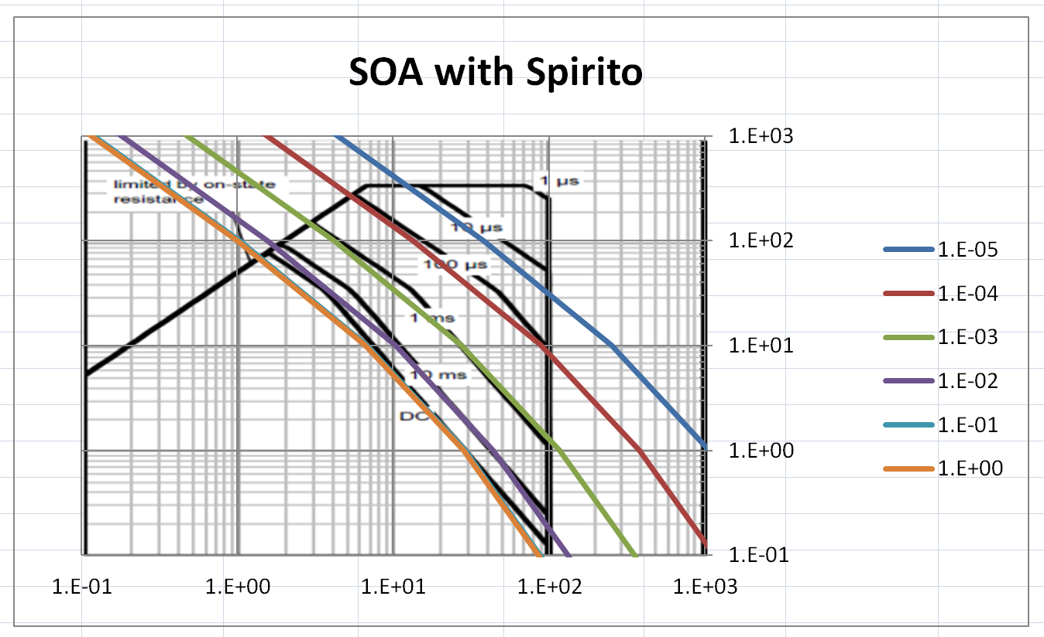
DanTherm Download Reminder
Download DanTherm: https://intranet.linear.com/documents/4570/DanThermBeta001.zip
There’s an mp4 video tutorial inside the zipfile.

Slide 3
Arduino The “Gateway” IDE?

Slide 4
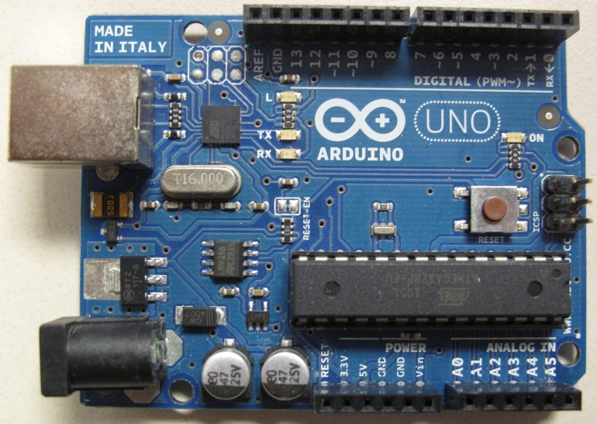
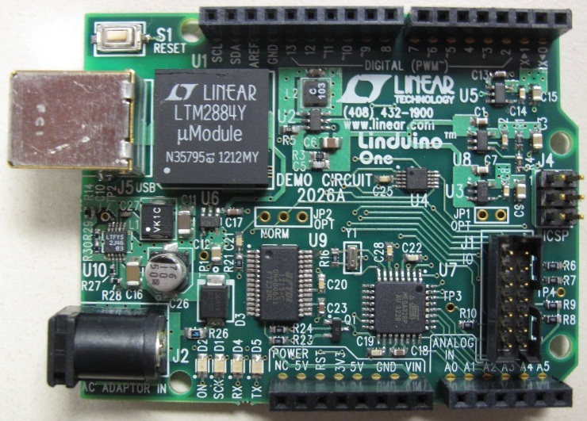
Arduino vs Linduino
C/C++ Programmable
Bootloader
Open-source
Add-on “shields”
AC adapter
USB serial port
All of that, plus…
QuikEval Connector
Isolated USB

Slide 5
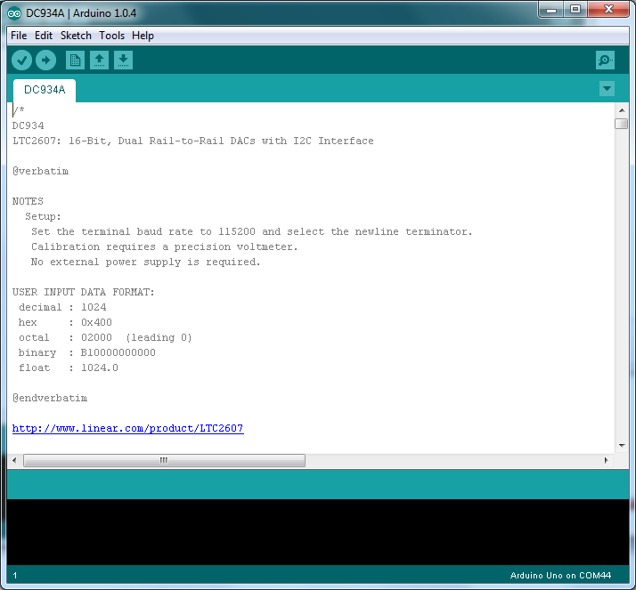
Arduino Integrated Development Environment (IDE) Edit, Compile, and Upload Firmware

Slide 6
Arduino Hardware
USB (Data and Power)
1) Upload Firmware (Your Program)
2) Serial Terminal Communication
Digital I/O
Power to Shield
Digital or Analog I/O
12V Power
(Optional) Allows standalone operation without PC or USB connection

Slide 7
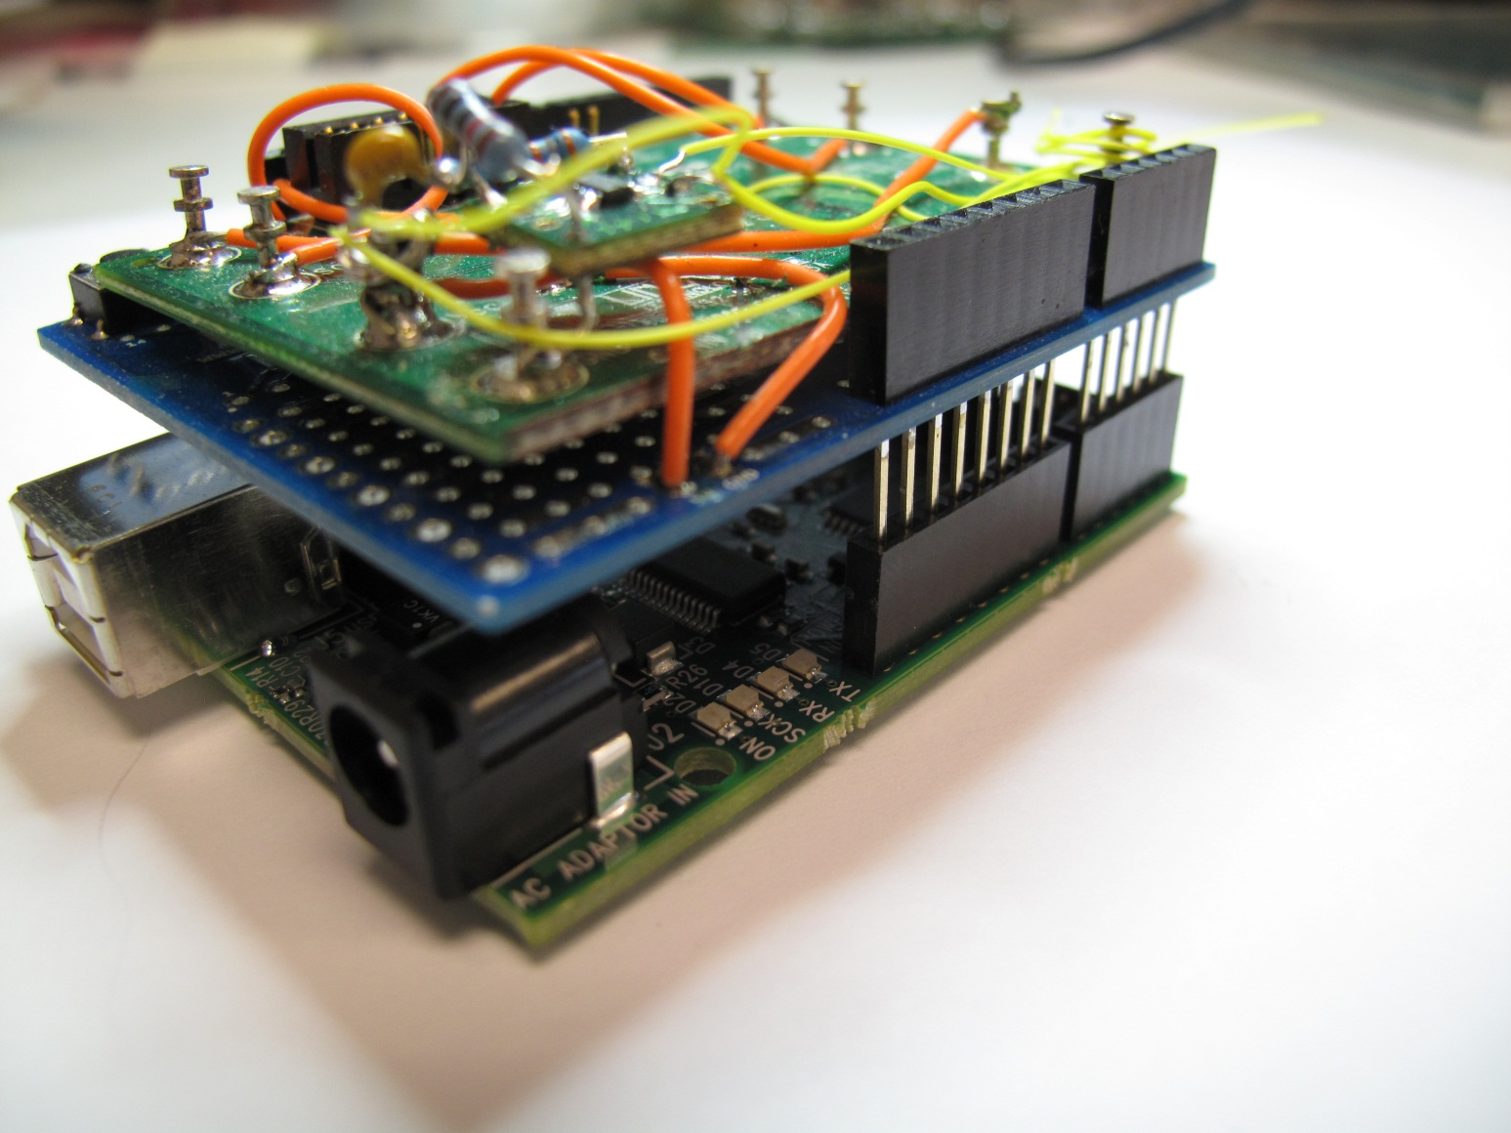
Arduino “Shields” Extend Functionality
Stackable
Headers

Slide 8
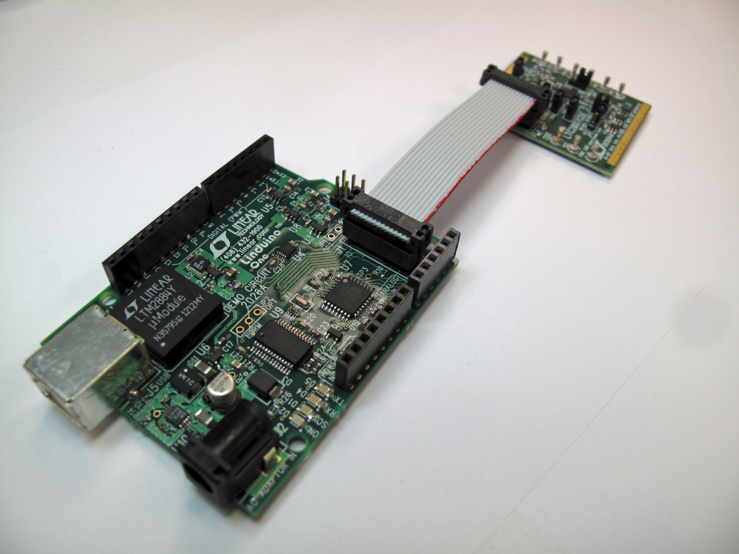
Linduino Adds Support for QuikEval Demo Boards

Slide 9

Do Your Customers Ask for Drivers?
If you are a Linear FAE because you hate software:
Direct customers to our ‘C’ libraries. Done.
If you are a little more adventurous:
Run the QuikEval GUI with a Linduino and demo board.
Then, fire up the Arduino IDE, upload the “demo code”, and watch it run.
Look at the ‘C’ code and see how it works.

Slide 10
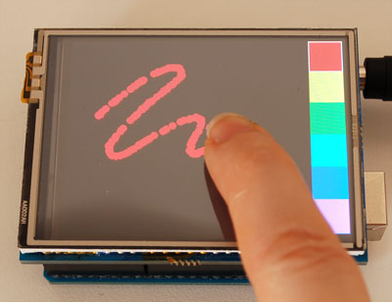
Want More?
Write your own code
Design your own projects
Multiple demo boards?
Arduino shields are abundant
Touchscreen, bluetooth, motor control, …
http://store.arduino.cc
https://www.sparkfun.com/
http://adafruit.com/
http://www.seeedstudio.com/
http://www.pololu.com/
http://www.shieldlist.org/
Try Atmel Studio
Free Microsoft Visual Studio-based IDE
In-circuit debugging possible with $50 AVR Dragon
http://www.adafruit.com/products/376

Slide 11
Homework – Before FAE Meeting!
If you are reading this on the big screen, you have done your homework and followed Demo Manual 2026 to Page 6, until the LTC2607 window pops up. This includes:
Installing Arduino 1.0.4 software
Updating QuikEval – The current version is K95 (upper left corner of welcome window)
Unzipping LTSketchbook onto your laptop
Verifying that your PC is talking to your Linduino
All required files are available at:
http://www.linear.com/designtools/linduino.php

Slide 12
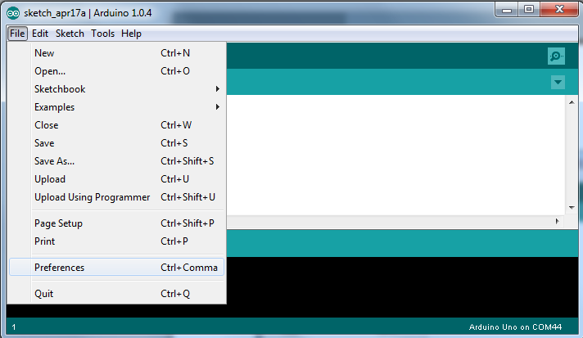
Arduino IDE
Open the Arduino IDE
Select File → Preferences

Slide 13
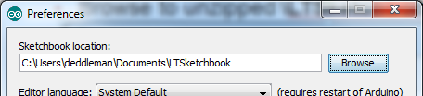
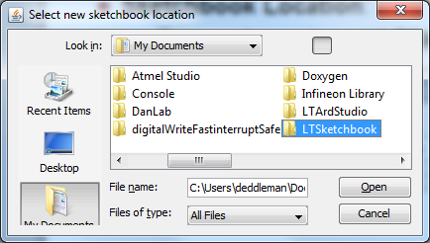
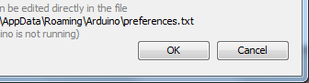
LTSketchbook Location Setup
Sketchbook Location:
Browse to unzipped \LTSketchbook.
Click Open and enter OK

Slide 14
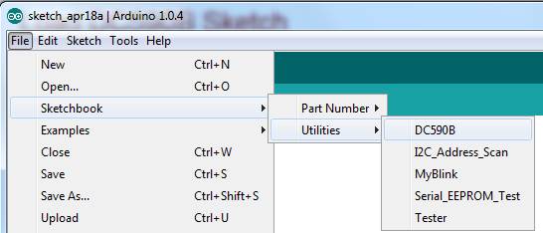
Load DC590B Sketch
Navigate to File→Sketchbook→Utilities→DC590B

Slide 15
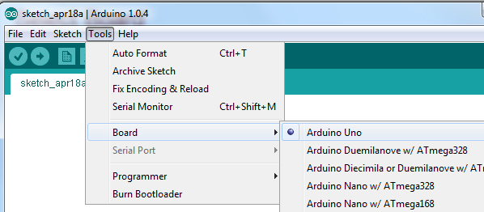
Select Board
Select Arduino Uno as Board Type
Tools→Board→Arduino Uno

Slide 16
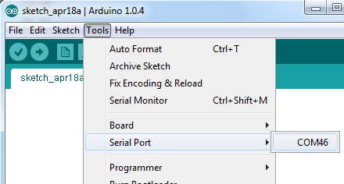
Select Serial Port
Select the appropriate COM port (trial-and-error is ok).
Tools→Serial Port→COMx

Slide 17
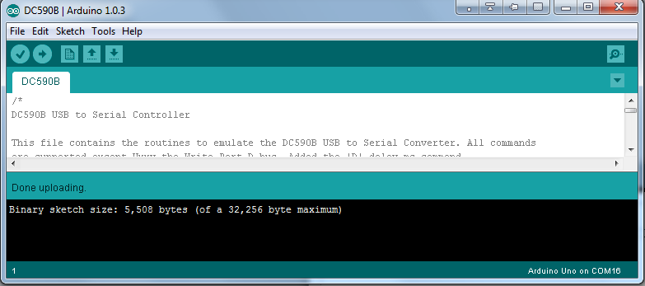
Upload
Press Upload Button
Verify that there are no error messages.

Slide 18
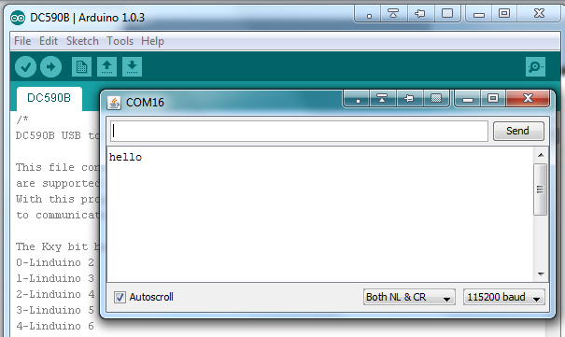
Serial Monitor
Open the Serial Monitor
Set Baud Rate to 115200
Set NewLine “NL” & Carriage Return “CR”
Check that you receive “hello”

Slide 19
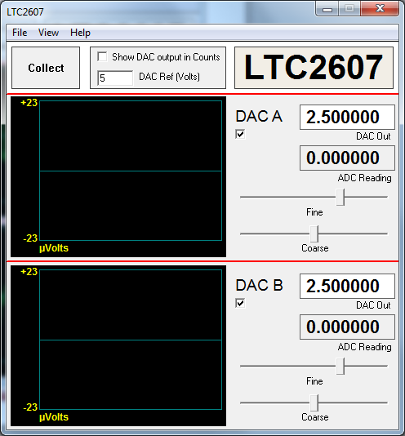
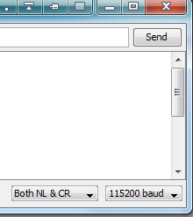
Close Serial Terminal and Open QuikEval
Close Serial Terminal
(Important!)
Then, open QuikEval
and press “Collect”

Slide 20
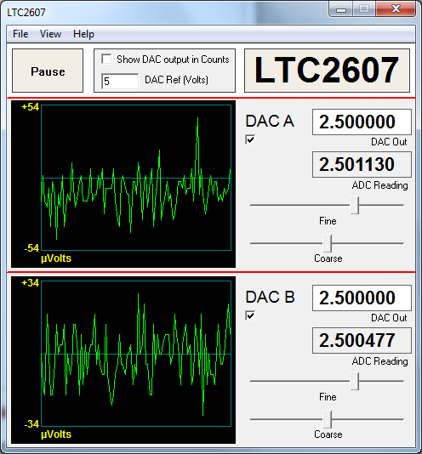
Collect Data
Verify QuikEval works.
Then, close application.

Slide 21
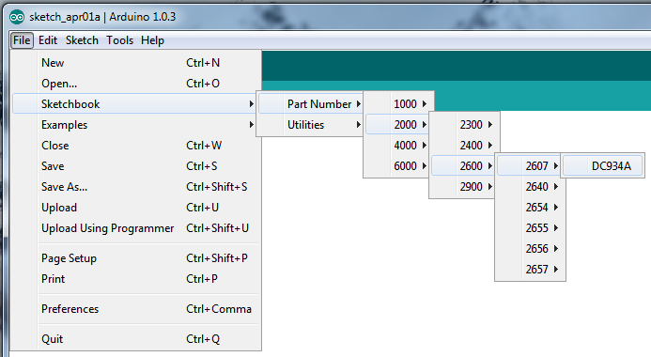
DC934A Demo Code
Open Sketchbook → Part Number→ 2000→ 2600→ 2607→ DC934A

Slide 22
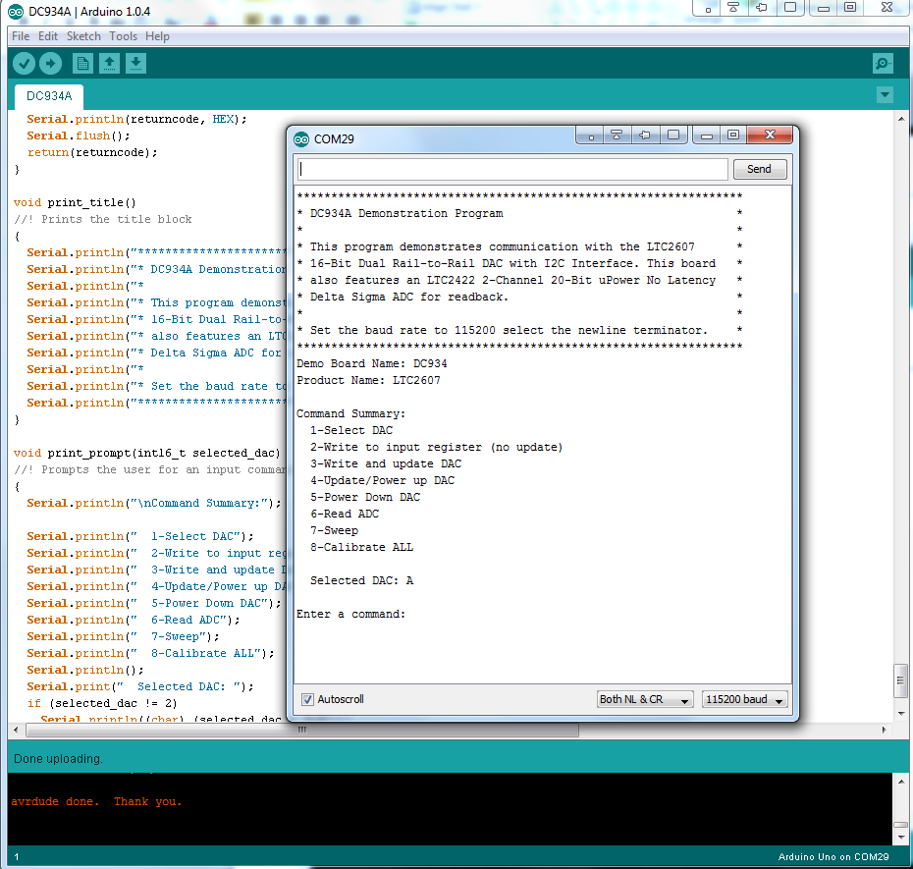
DC934A Demo Code
Press Upload
Serial Monitor

Slide 23
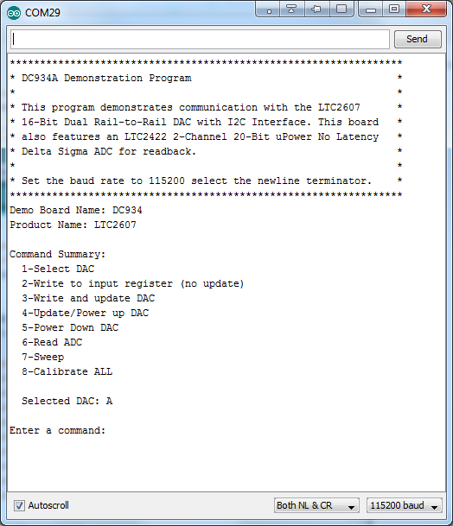
Open Serial Monitor and Give it a Try
Try option “7-Sweep”, 10 sample points.

Slide 24
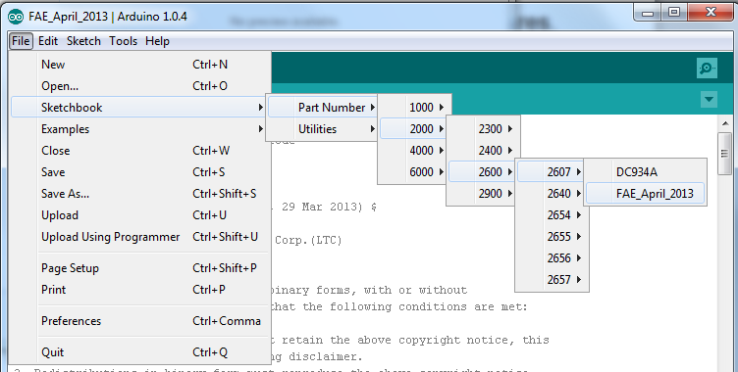
Simple Science Project
DC934A Demo Code demonstrates many features.
For something simpler, load FAE_April_2013.

Slide 25
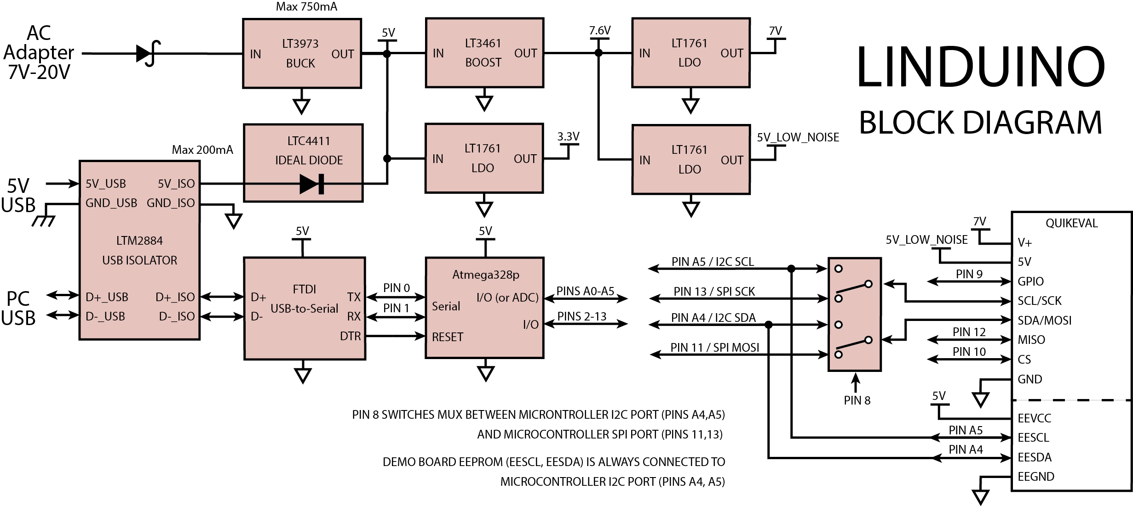
Block Diagram

Slide 26
Science Project – Setup, Loop
Every Arduino “sketch” (*.ino filename) contains a setup() function and a loop() function. This is specific to Arduino.
Setup()
{
// Runs once upon power-up or a reset
}
Loop()
{
// Repeats continuously.
}
Advanced: Arduino convention hides C/C++ main(), which calls setup(), loop(), and the serial communication handler.

Slide 27
Science Project – Serial
USB
Serial
5V RS-232

Slide 28
Science Project – Arduino Serial Communication
Serial library (class) makes communication with the Arduino/Linduino, super-simple
Serial.begin(115200) sets the baud rate to 115200
Serial.print(“String”) prints “String”
Serial.println(“String”) prints “String” plus newline
Serial.available() checks if characters are waiting to be read
Serial.read() reads one character
Advanced: the serial RX/TX are also connected to pins 0/1 of the shield header.

Slide 29
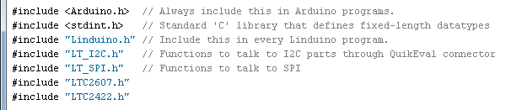
#include Files
#include a header file for every library.
Linduino programs require “Arduino.h” and “Linduino.h”
“LT_I2C.h” is required for I2C, “LT_SPI.h” for SPI.
Part libraries are named “LTpart.h”
Advanced: Compiler automatically searches LTSketchbook/Libraries directory for matching *.cpp files. Arduino linker links libraries based on #include list in *.ino

Slide 30
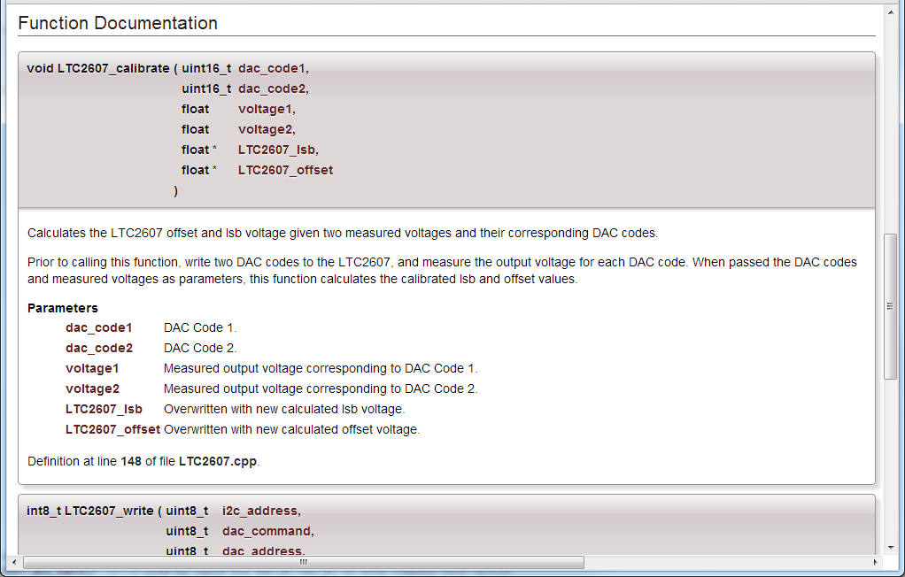
Open LTSketchbook/Linduino.html

Slide 31
QuikEval Functions
Initialize I2C and SPI using
quikeval_I2C_init()
quikeval_SPI_init()
Switch between I2C and SPI
quikeval_I2C_connect()
quikeval_SPI_connect()
SPI Chip Select is defined as QUIKEVAL_CS (Arduino pin 10)
Advanced: *_connect() functions drive QUIKEVAL_MUX_MODE pin high or low to switch MUX. (Arduino pin 8)

Slide 32
QuikEval Connector
QuikEval I2C/SPI
I2C/SPI MUX

Slide 33
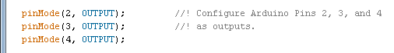
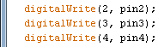
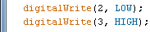
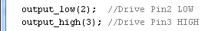
Pins – Configuring, Reading and Writing
Pins are numbered 0 to 13 and A0 to A5 (look at silkscreen)
PinMode can be set to OUTPUT, INPUT, or INPUT_PULLUP
To set pin high or low
digitalWrite(pin#, HIGH or LOW) - Arduino standard
output_low(pin#), output_high(pin#) – Linduino only
To read pin
digitalRead(pin#)

Slide 34
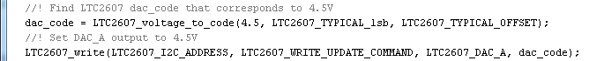
CONSTANTS
Constant bit settings, lsb weights, etc. are defined in the “LT_part.h” file in ALL_CAPS (by ‘C’ convention).
Use HTML browser to look at LTSketchbook\Linduino.html
select Modules → LTC2607 → LTC2607.h
Bitwise operations are useful to combine settings
OR => CONST1 | CONST2
AND => CONST1 & CONST2

Slide 35
#include <stdint.h> Datatypes
Defines fixed-length integer datatypes
The number of bytes used to represent the integer types defined in <stdint.h> is guaranteed to be the same on any processor
Stdint.h | Translation
int8_t, uint8_t | signed/unsigned 8-bit integer
int16_t, uint16_t | signed/unsigned 16-bit integer
Int32_t, uint32_t | signed/unsigned 32-bit integer

Slide 36
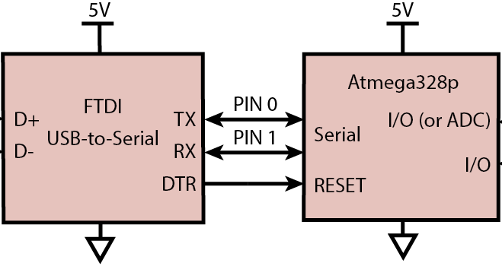
Bootloader? No external programmer required!
If the “bootloader” detects a special sequence on the serial port immediately after the uC is RESET, the subsequent serial data is loaded into nonvolatile program memory.
The Arduino IDE can force a RESET using the DTR line of the serial port.
If the sequence is not detected, the normal (previously loaded) program runs.

Slide 37
Stuff you don’t need to know, yet…
#ifdef, #endif for compiler
Don’t worry about it if you don’t understand
//!, /*!, // @xxx, comments are formatted for the automatically generated HTML documentation.
Don’t worry about it unless you REALLY want to know.

Slide 38
Caveats
We’re still in beta
We’re writing software as fast as we can
Help us find our bugs… and please forgive them
Use good judgment. If you show the Linduino to your customers, make sure they understand it is beta.

Slide 39
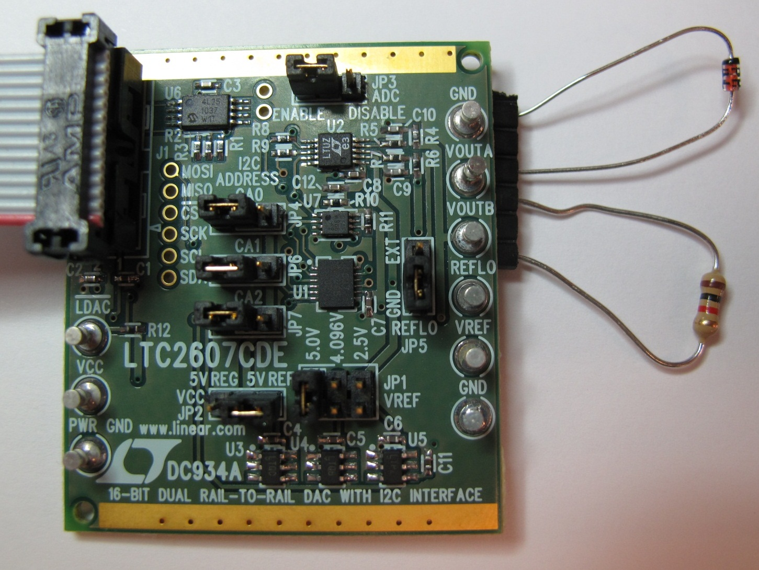

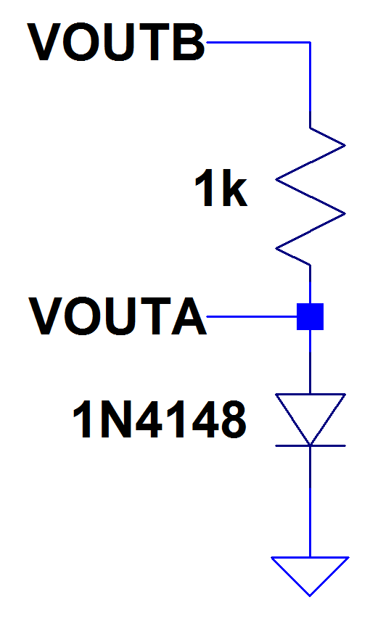

Fun!

Slide 40
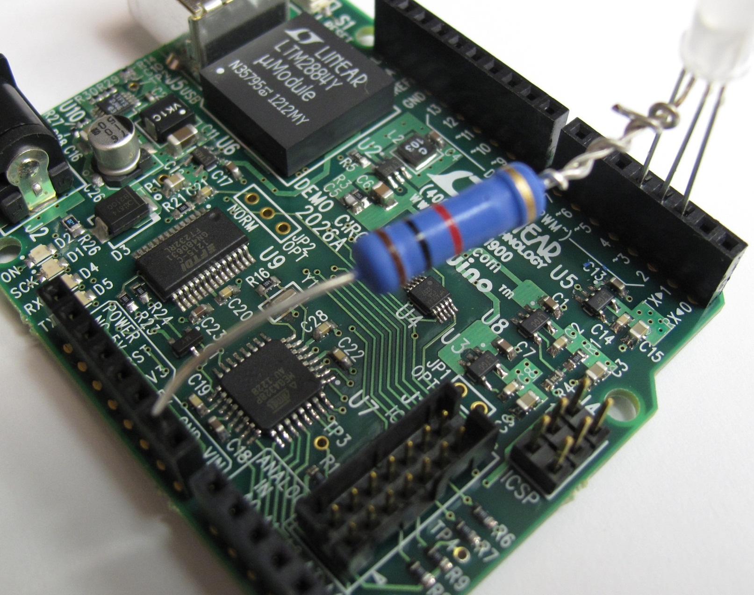
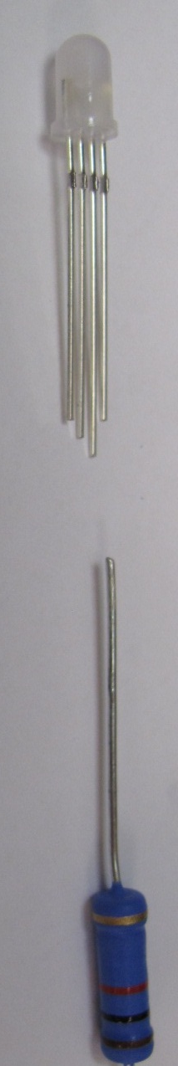
PINS 2,3,4
GND

Slide 41
Troubleshooting your own hardware/software
Pins 0,1 are Serial Port TX/RX.
Use other pins first.
If all else fails, run Arduino Blink Example.
Check if LED blinks.

Slide 42
Suggested References
Language: http://arduino.cc/en/Reference/HomePage
Atmel Specific:
Forum: http://www.avrfreaks.net/
Advanced:
Arduino Internals: http://www.apress.com/9781430238829
Google C++ Style Guide: http://google-styleguide.googlecode.com/svn/trunk/cppguide.xml
Embedded C Programming and the Atmel AVR (Barnett, Cox, and O’Cull)

Slide 43
Pointer Review – It’s ok, everyone’s rusty…
If you want to read an ADC code, call the function: adc_read(&adc_code, …
‘&’ means the function can modify the value in adc_code
‘&’ means you are passing the memory address of adc_code
The person who wrote the function adc_read declared it as: adc_read(uint8_t* adc_code, … { i2c_start()… *adc_code=i2c_read(… }
‘*’ in ‘*adc_code’ means to modify the value at memory location “pointed to” by &adc_code
If you don’t understand, just follow an example…

